Slide 1

Ruturaj Abnave

Slide 2

Revolutionizing Freight Transport with DigiHaul

Slide 3

Introduction
Title: Analysis of Shipment Delivery Data
Objective: To evaluate the on-time delivery performance and identify potential delays for shipments between October 1st and December 31st, 2023.
Data Overview
Data Sources:
1.Shipment Bookings
2.GPS Data
Stakeholders:
Senior non-technical stakeholders needing high-level insights and actionable recommendations.

Slide 4

Key Metrics and Definitions
On-Time Delivery:
Deliveries made within the scheduled latest delivery time plus a 30-minute buffer.
On-time Deliveries:
Deliveries made before the earliest scheduled delivery time.
Total on time Deliveries:
Sum of on-time and early deliveries.
Late Deliveries:
Deliveries made after the scheduled latest delivery time plus the 30-minute buffer.

Slide 5
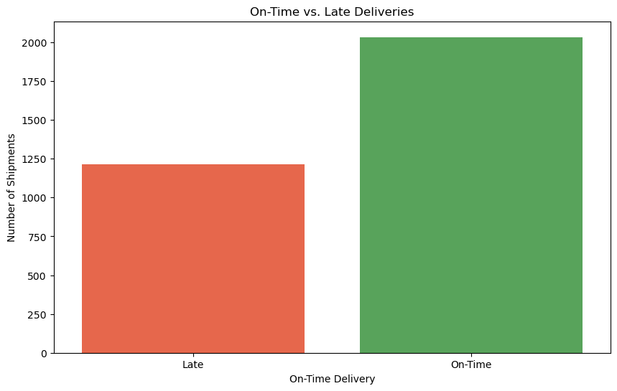
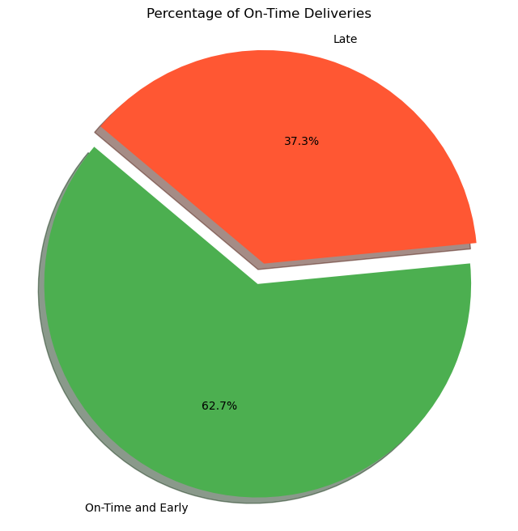
Analysis Result

Slide 6

Overall Performance:
Total Shipments Analyzed: 3245
Number of shipments within the analyzed period: 1 October 2023 to 31 December 2023.
Total Deliveries: 3245
Percentage of shipments that met the on-time or early delivery threshold: 62.65%.
On-Time Delivery Breakdown:
On-Time Deliveries:
18.98 % of shipments delivered within the scheduled time window.
Early Deliveries:
42.28% of shipments delivered before the scheduled earliest time, suggesting potential scheduling adjustments.
Late Deliveries:
Number of Late Deliveries:
Shipments delivered later than the scheduled latest time plus the 30-minute buffer: 1212 shipments.
Potential Late Deliveries: 1212
Identification and notification of shipments at risk of late delivery

Slide 7

Total Shipments Analyzed: 3245
Number of shipments within the analyzed period: 1 October 2023 to 31 December 2023.
Total Deliveries: 3245
Percentage of shipments that met the on-time or early delivery threshold: 62.65%

Slide 8
Potential Late Deliveries
Identification:
Shipments with actual delivery times later than the scheduled latest delivery time plus the 30-minute buffer.
Notification Timing:
Send notifications 30 minutes before the scheduled latest delivery time to proactively manage delays.

Slide 9
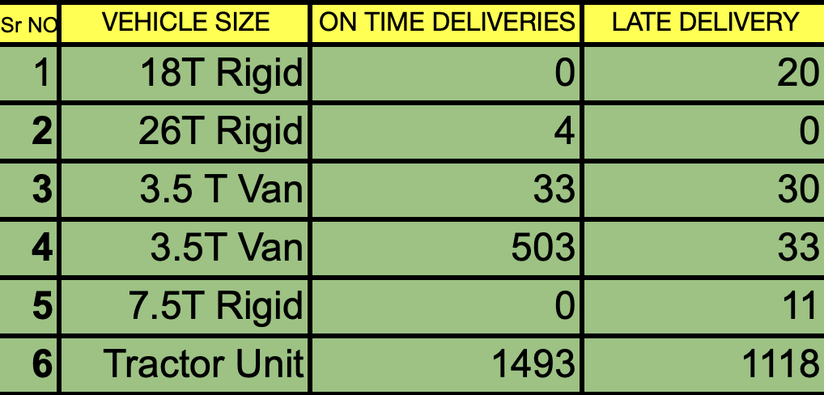
Vehicle Analysis
Vehicle size performance

Slide 10
Vehicle Performance-Delay Caused
18T Rigid: 100% late deliveries (20 out of 20).
26T Rigid: 100% on-time deliveries (0 out of 4).
3.5T Van: 91% on-time deliveries (3 late out of 33).
7.5T Rigid: 100% late deliveries (11 out of 11).
Tractor Unit: 75% late deliveries (1118 out of 1493)

Slide 11
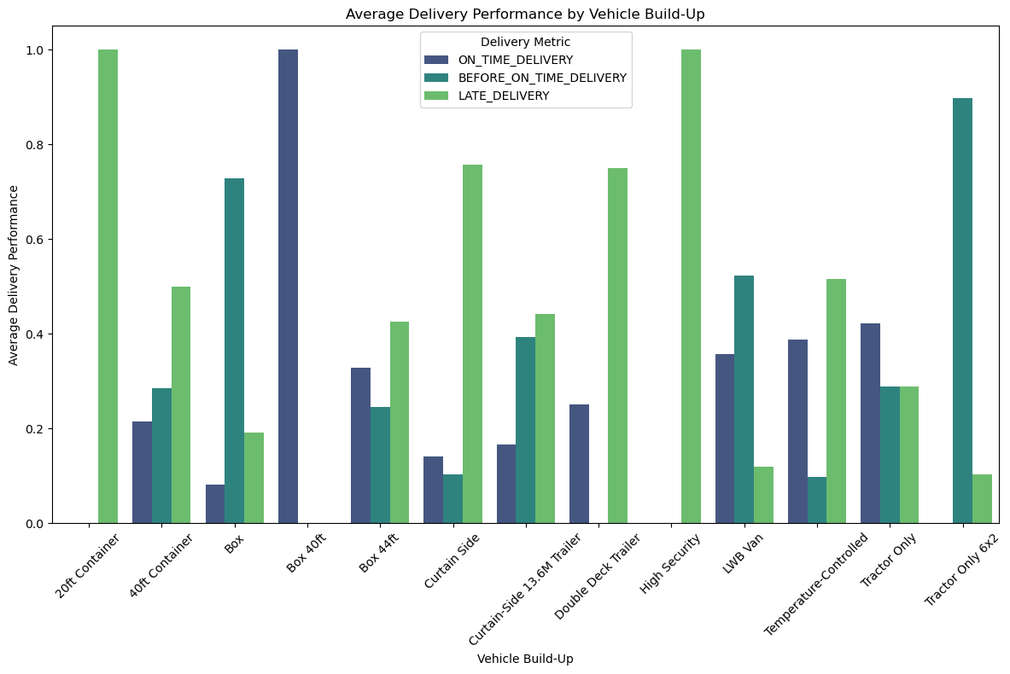
Vehicle build up

Slide 12
Insights on Delivery Performance:
Late Deliveries:
Top Categories: Curtain-Side 13.6M Trailer (784), Box 44ft (201), Box (79) have the most late deliveries.
Insight: These categories face challenges in meeting delivery schedules, especially the Curtain-Side 13.6M Trailer and Box 44ft.
Before Time Deliveries:
Top Categories: Curtain-Side 13.6M Trailer (294), LWB Van (131), Box (34) show significant deliveries before the expected time.
Insight: Curtain-Side 13.6M Trailer often completes deliveries before time, suggesting efficient scheduling or logistics management.
On-time (Before or On-time) Deliveries:
Top Categories: Curtain-Side 13.6M Trailer (699), Box (302), LWB Van (192) are the most successful in on-time deliveries.
Insight: Curtain-Side 13.6M Trailer, Box, and LWB Van consistently achieve on-time deliveries, indicating effective operational planning.

Slide 13
Notifications for Potential Delays
Process:
Identified shipments at risk of late delivery and calculated the notification times.
Example Notification:
"Shipment XYZ is potentially late. Notification time: [specific time]."
Columns for Notification:
SHIPMENT_NUMBER, LAST_DELIVERY_SCHEDULE_LATEST, ACTUAL_DELIVERY_TIME, NOTIFICATION_TIME, ON_TIME_DELIVERY.

Slide 14

Suggested Next Steps
Refine Scheduling Accuracy
Action: Utilize historical data and analytics to improve the accuracy of delivery time estimates.
Benefit: Reduces instances of early deliveries, optimizing resource utilization and improving operational efficiency.
Stakeholder Communication Protocol
Action: Establish a clear and standardized communication protocol for notifying stakeholders about potential delays and early deliveries.
Benefit: Enhances transparency and trust with customers and partners, allowing for better customer service and expectation management.
Performance Analysis and Review
Action: Conduct regular reviews and analysis of delivery performance metrics.
Benefit: Identifies trends and patterns in delivery times, enabling continuous improvement of operational processes.
Operational Adjustments
Action: Implement operational adjustments based on analysis findings, such as optimizing delivery routes or adjusting scheduling windows.
Benefit: Improves delivery efficiency and reduces the occurrence of both early and late deliveries.

Slide 15

Conclusion
Implementing these suggested next steps will not only address the issues identified in the analysis but also improve overall delivery performance, customer satisfaction, and operational efficiency. Continuous monitoring and evaluation of these actions will be essential to ensure sustained improvement in delivery times and service quality.

